Slide 1
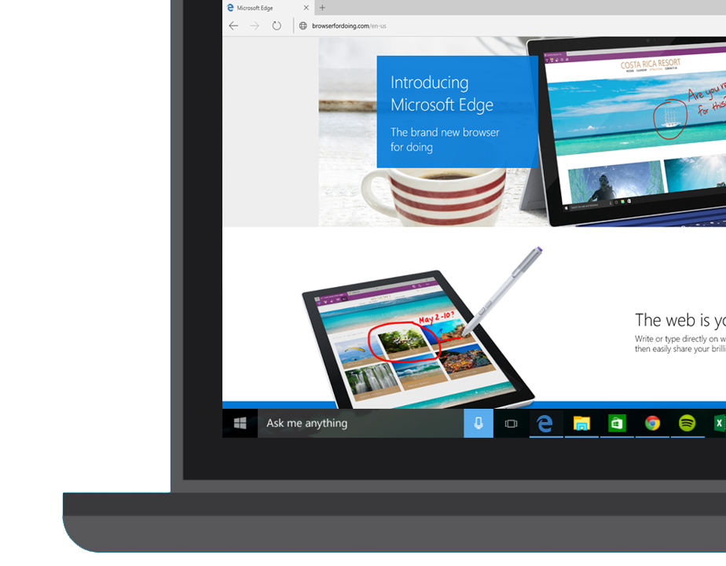
Microsoft Edge and Web App Platform
David Catuhe, @deltakosh
Jeff Burtoft, @boyofgreen

Slide 2
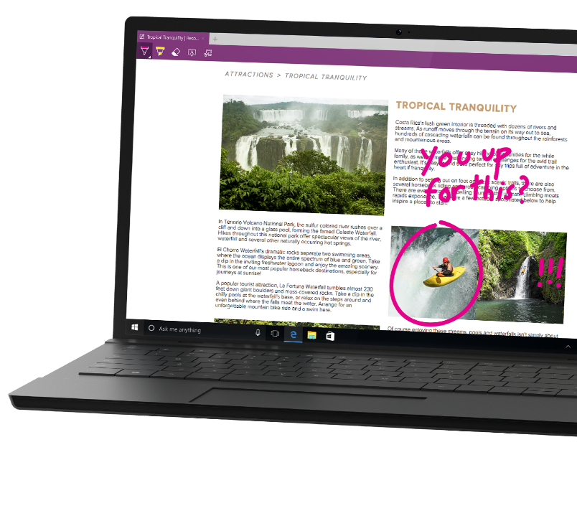
What is Microsoft Edge?

Slide 3
44 Billion
Web sites

Slide 4
Trillions
of URLs crawled every day

Slide 5
1995
2015
1
2
3
4
4.x
5
5.5
6
7
8
9
9
10
11
Trident

Slide 6

HTML4, ES3, CSS2
1995
1995
2015
1
2
3
4
4.x
5
5.5
6
7
8
9
9
10
11
Trident
Quirks
Strict
!DOCTYPE

Slide 7

HTML4, ES3, CSS2
CSS2.1
1995
2015
1
2
3
4
4.x
5
5.5
6
7
8
9
9
10
11
Trident
!DOCTYPE
IE5
Quirks
IE7
Compatibility View
IE8
Standards Mode
x-ua-compatible

Slide 8

HTML5, SVG, ES5
HTML4, ES3, CSS2
CSS2.1
1995
2015
1
2
3
4
4.x
5
5.5
6
7
8
9
9
10
11
Trident
IE5
Quirks
IE7
Compatibility View
IE8
Standards Mode
!DOCTYPE
x-ua-compatible
IE9
Standards Mode

Slide 9
HTML5, SVG, ES5, CSS3
HTML4, ES3, CSS2
CSS2.1
1995
2015
1
2
3
4
4.x
5
5.5
6
7
8
9
9
10
11
Trident
IE5
Quirks
IE7
Compatibility View
IE8
Standards Mode
!DOCTYPE
x-ua-compatible
IE9
Standards Mode
QME
Quirks Mode Emulation
IE10
Standards Mode

Slide 10
Modern Web
HTML5, SVG, ES5, CSS3
Legacy Web
CSS2.1
HTML4, ES3, CSS2
1995
2015
1
2
3
4
4.x
5
5.5
6
7
8
9
9
10
11
Trident
IE5
Quirks
IE7
Compat View
IE8
Standards Mode
EMIE
Enterprise Mode
!DOCTYPE
x-ua-compatible
IE9
Standards Mode
IE10
Standards Mode
QME
Quirks Mode Emulation
IE11
Standards Mode

Slide 11
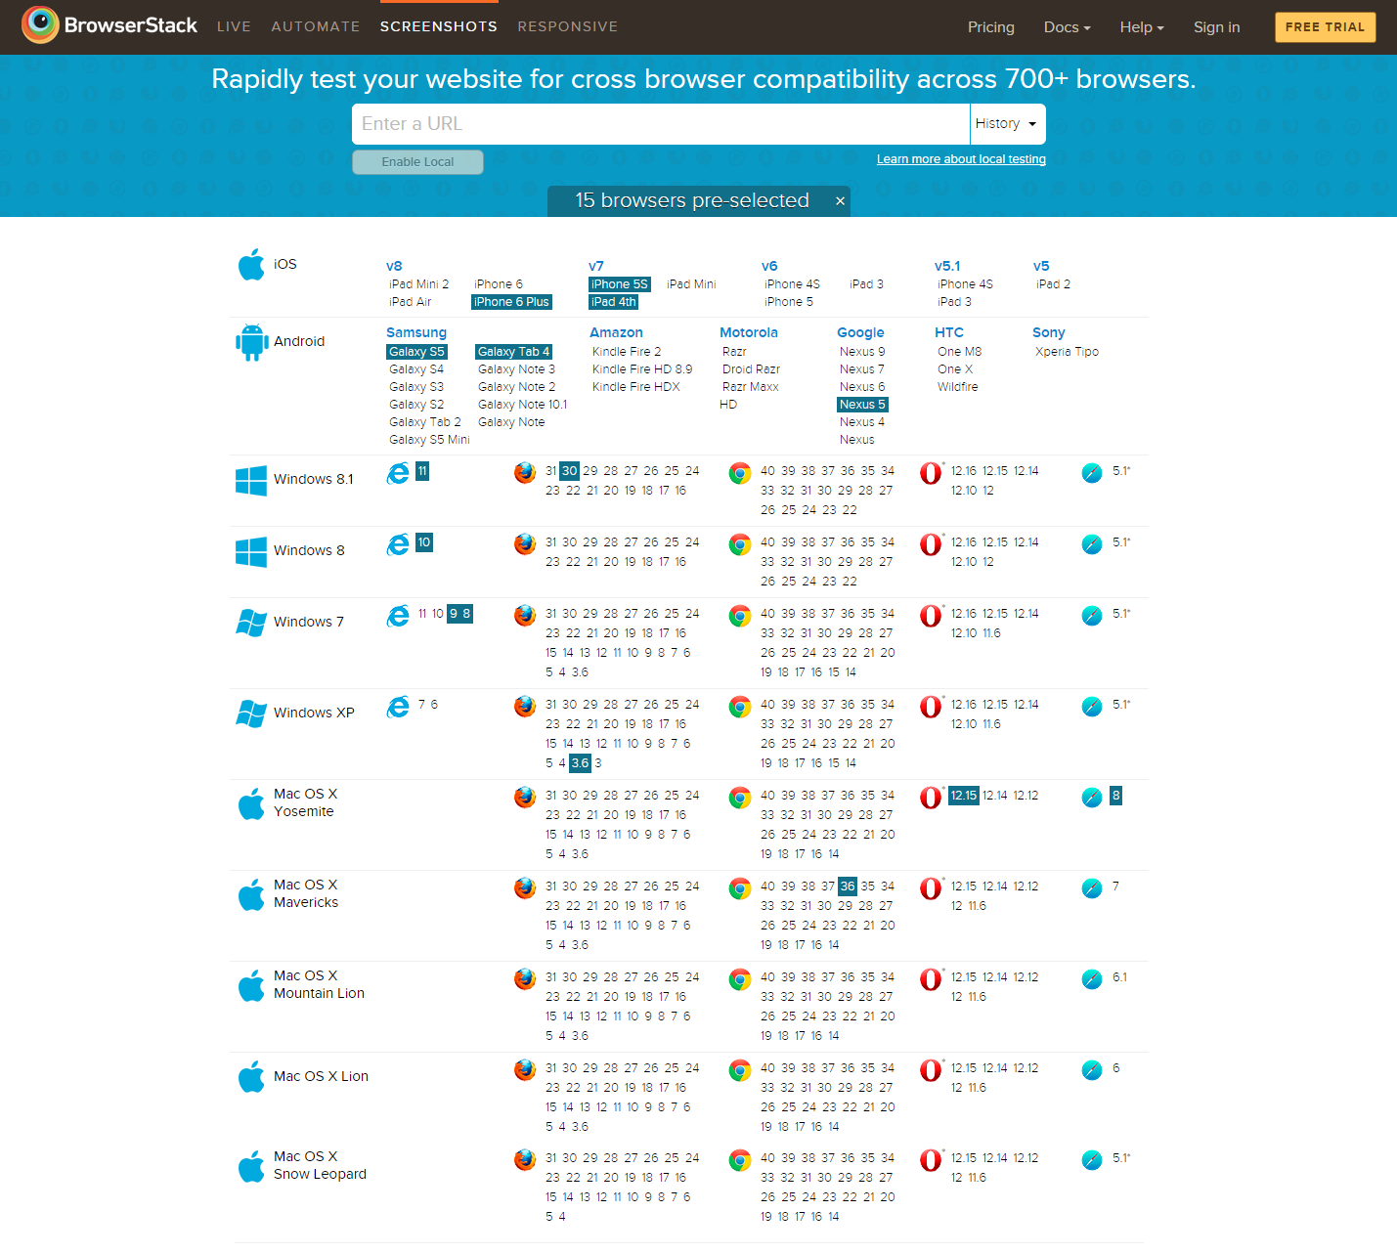

Slide 12
Mobile Chromium usage across forks
Chromium 28 – 27%
Chromium 33 – 6%
Chromium 35 – 1%
Chromium 38 – 1%
Chromium 40 – 39%
Chromium versions
<10
Chromium 39 – 3%
Chromium 37 – 2%
Chromium 30 – 1%
Chromium 30 – 18%
Chromium 18 - 2%
Source: www.quirksmode.org/blog/archives/2015/02/counting_chromi.html

Slide 13
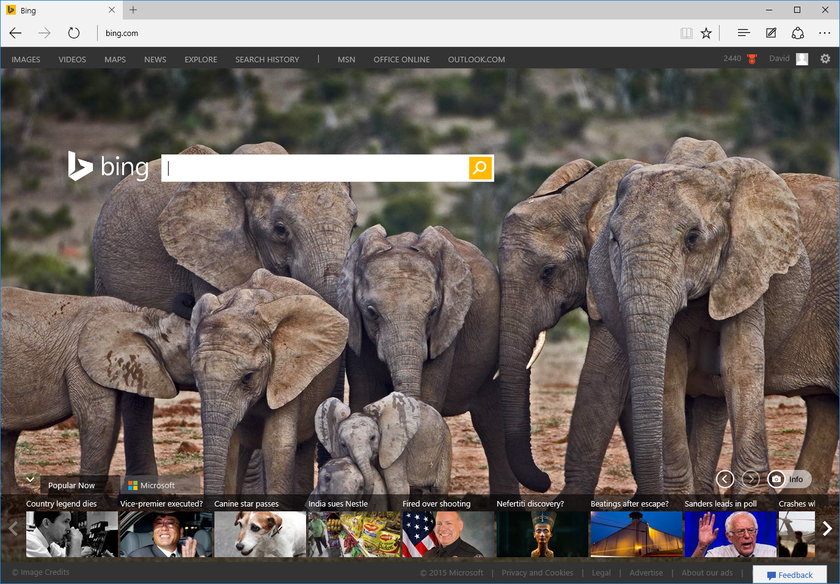
IntroducingMicrosoft Edge

Slide 14

Always up-to-date
EdgeHTML
Chakra
EdgeHTML
Chakra

Slide 15
Performances

Slide 16
Performances

Slide 17
Security
App Container Sandbox
Web pages are rendered inside an app container, the latest and most secure client-side app sandbox in Windows
64bits by default
64-bit processes get significant security advantages by making Windows ASLR (Address Space Layout Randomization) stronger
MemGC
Memory Garbage Collector is a memory garbage collection system that defend the browser by taking responsibility for freeing memory away from the web developer

Slide 18




User-Agent Strings
Mozilla/5.0 (Windows NT 10.0; WOW64; rv:35.0) Gecko/20100101 Firefox/35.0
Mozilla/5.0 (Macintosh; Intel Mac OS X 10_10_1) AppleWebKit/600.1.25 (KHTML, like Gecko) Version/8.0 Safari/600.1.25
Mozilla/5.0 (Windows NT 10.0; WOW64) AppleWebKit/537.36 (KHTML, like Gecko) Chrome/40.0.2214.93 Safari/537.36
Mozilla/5.0 (Windows NT 10.0; WOW64) AppleWebKit/537.36 (KHTML, like Gecko) Chrome/39.0.2171.71 Safari/537.36 Edge/12.0

Slide 19
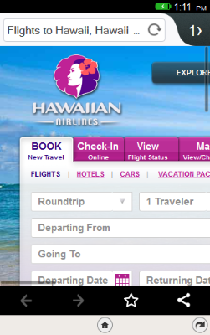
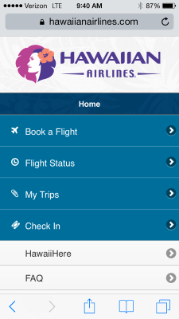



Slide 20
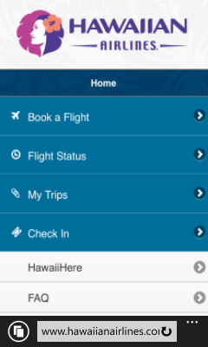


Slide 21
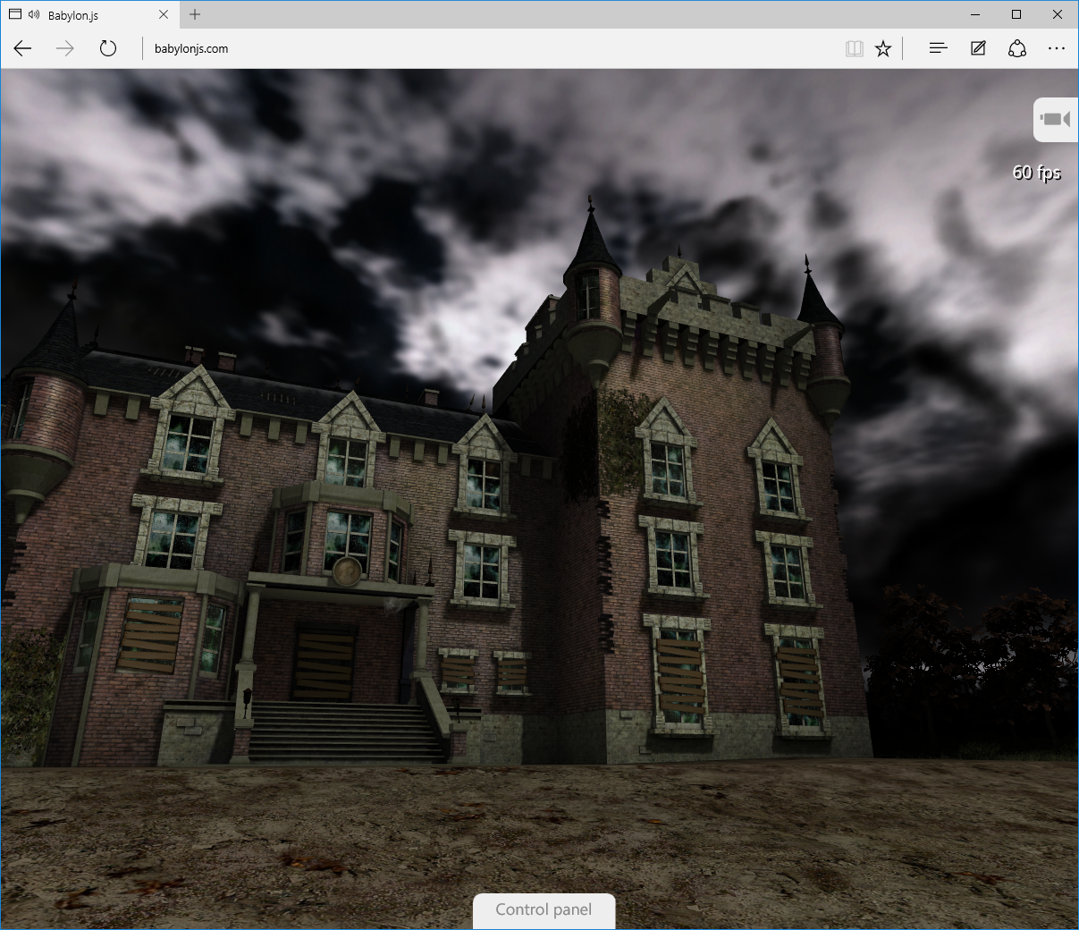
New features

Slide 22

Microsoft EdgeHTML
Microsoft Edge
JS Symbols
ES6 Numbers Built-Ins
DOM L3 XPath
Rest parameters
4200+ interoperability improvements
ES6 Template Strings
Arrow function
asm.js
JS iterators
<img srcset>
Web Audio API
ES6 classes
GamePad API
Content Security Policy
Video tracks
ES6 Promises
Selection API
ES6 Math Built-Ins
HTTP Strict Transport Security
Touch Events
Media Queries L4 Interaction Media
ES6 String Built-Ins
ES6 WeakSet
getUserMedia()
ES6 Spread
preserve-3d
ES6 Proxies
ES6 Object Built-Ins
HTTP/2
WAV audio
HTTP Live Streaming
Date <input> types
Motion JPEG
Generators

Slide 23
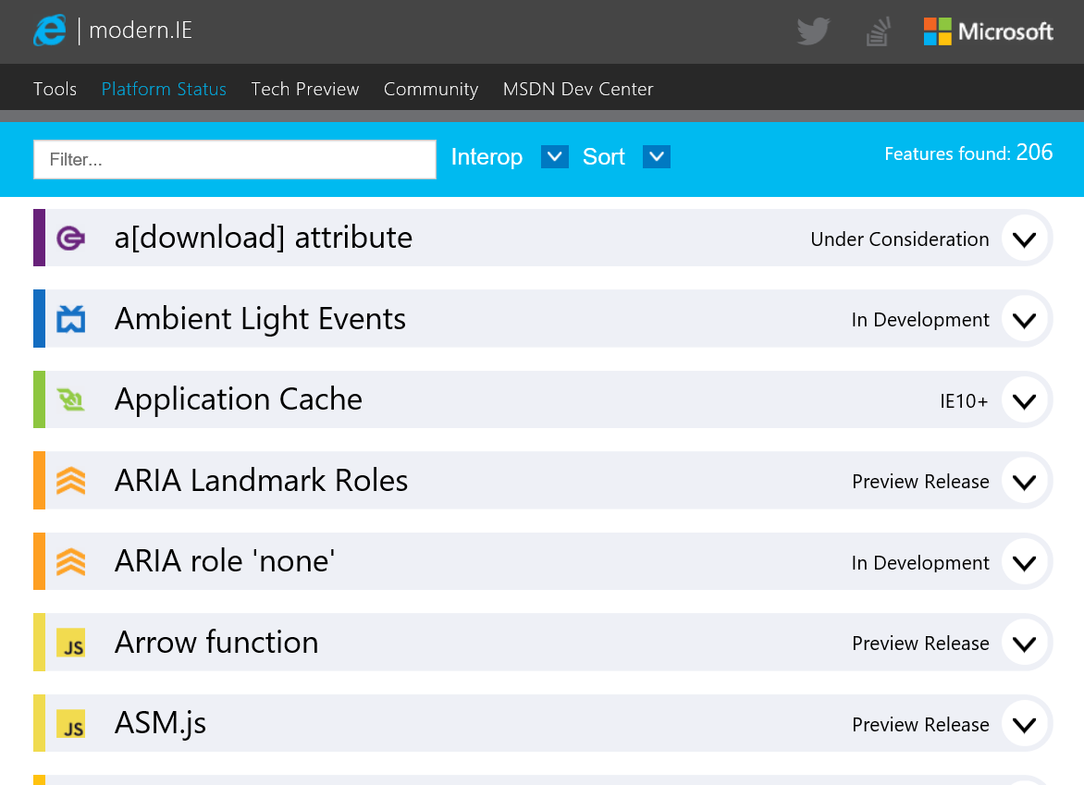
status.modern.ie

Slide 24
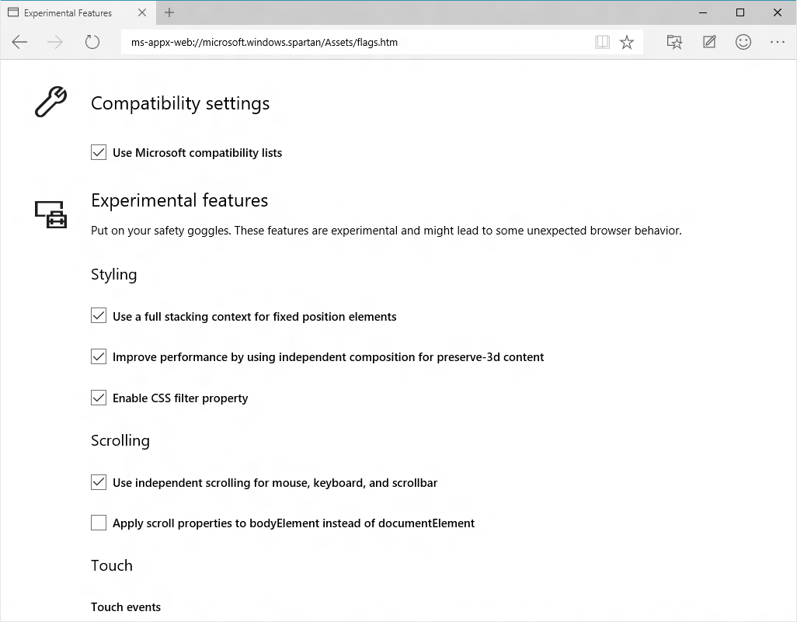
About:flags

Slide 25
Windows Web Platform

Slide 26
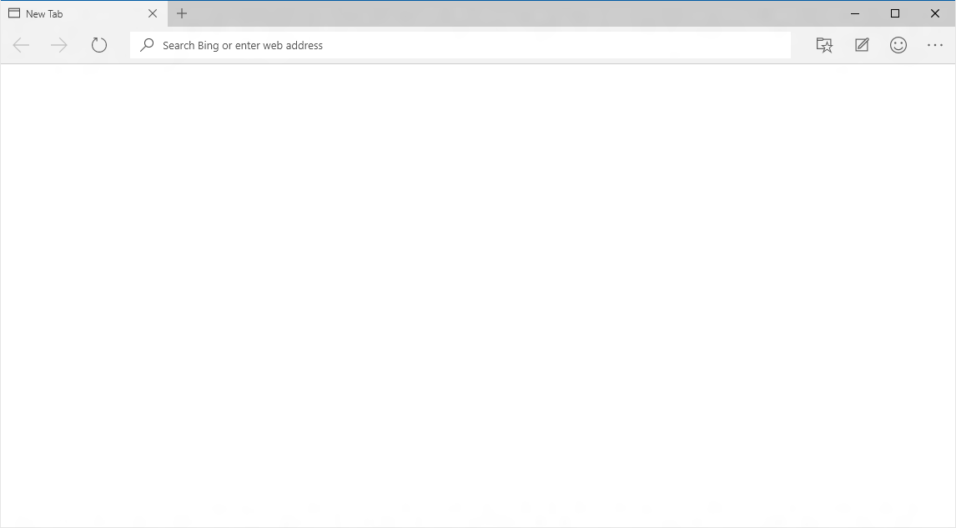
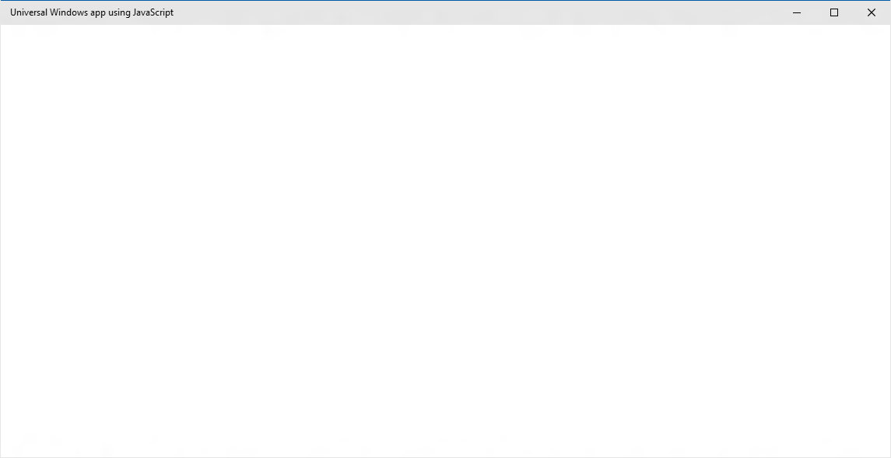
EdgeHTML.dll
Chakra
Packaged content
Offline first
Hosted content
Always up-to-date
WebView

Slide 27
Packaged content
Offline first

Slide 28
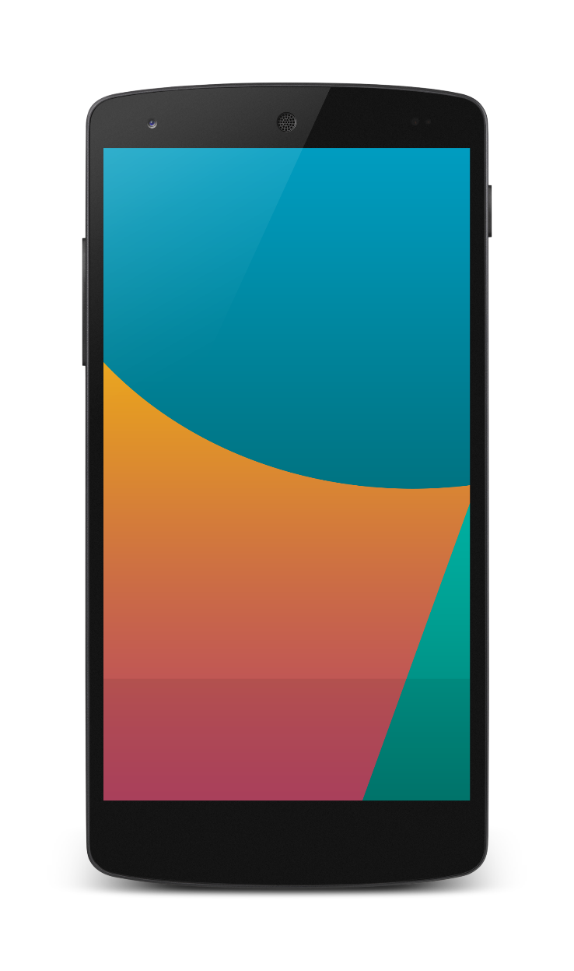
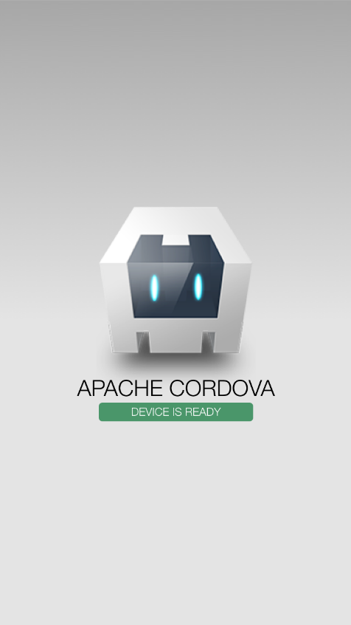

Packaged apps and tools investments
Build apps for iOS, Android & Windows
Nearly 100% shared code
Debug on any device or emulator
Use the JavaScript frameworks you love
Support for offline

Slide 29
WebView

Slide 30
WebView Control
Uses the always current Edge rendering engine
Improved app performance and responsiveness
Improved App to WebView communication
Enables Windows Runtime access

Slide 31
DEMO Webview

Slide 32
Hosted content
Always up-to-date

Slide 33
Microsoft Edge
NEW: Hosted Web Apps
Bring your website experience to the Windows Store
Leverage your web investments and developer workflow
Full access to Universal APIs like
Tiles, Notifications, Camera, Contact List, Calendar
.appx
HTML
CSS
JS
Universal Windows Platform

Slide 34
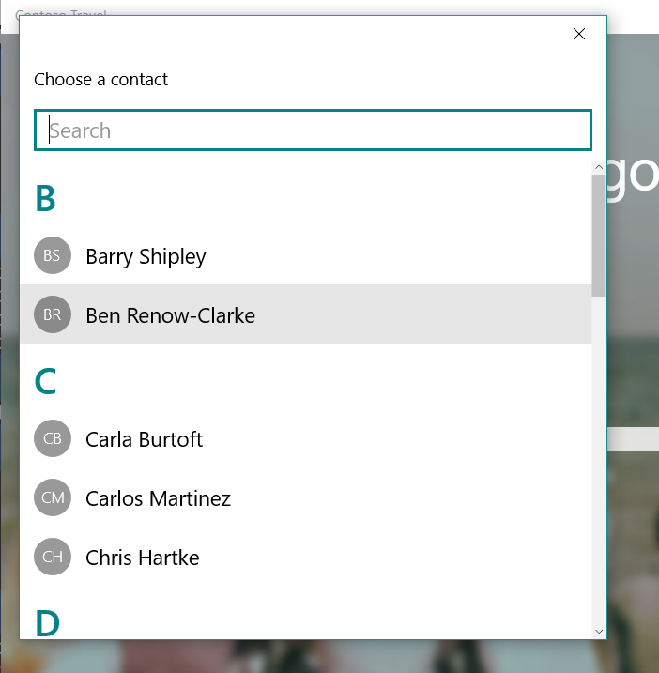
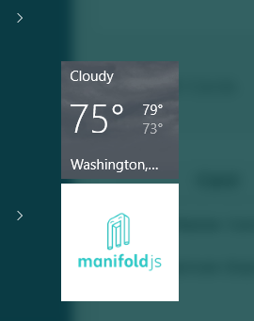
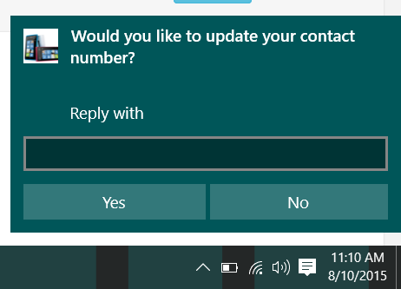
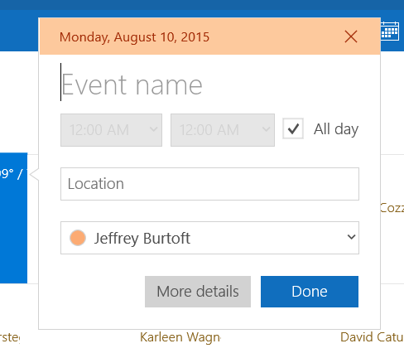
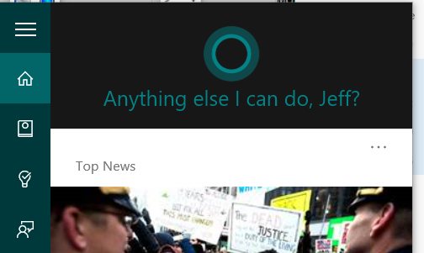
Windows APIs

Slide 35
DEMO Hosted Web App

Slide 36
W3C Standard
{
"name": "Super Web App",
"short_name": "SuperWA",
"start_url": "http://www.example.com",
"icons": [
{
"src": "tiny.png",
"sizes": "70x70"
},
{
"src": "square.png",
"sizes": "150x150"
},
{
"src": "apple-touch-icon-72x72-precomposed.png",
"sizes": "72x72"
},
{
"src": "niceicon.png",
"sizes": "128x128"
}
],
"display": "standalone",
"orientation": "landscape"
}
Manifest for Web Apps
http://w3c.github.io/manifest/

Slide 37
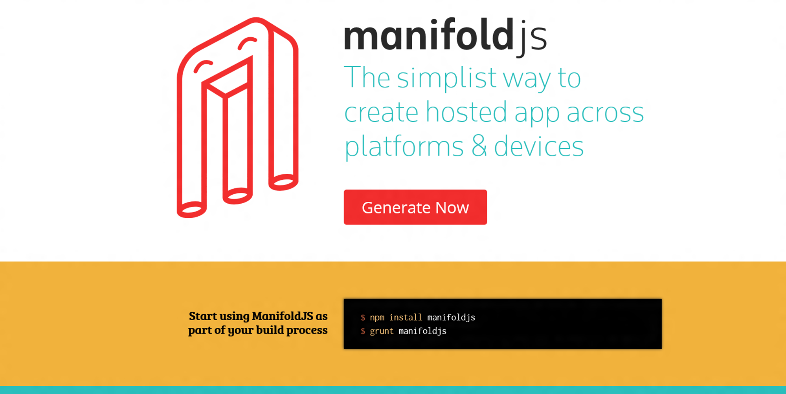

Slide 38
DEMO ManifoldJS

Slide 39
Going further….
Microsoft Edge: dev.modern.ie
Web App Platform: http://dev.windows.com
Cordova: aka.ms/cordova
Manifoldjs: www.manifoldjs.com
Project Westminster: http://blogs.windows.com/buildingapps/2015/07/06/project-westminster-in-a-nutshell/

Slide 40
Thank you! Questions ?

